Slide 1
Web Applications CT050-3-2 (VD1)
ASP.Net

Slide 2
Topic & Structure of The Lesson
Understand Static Web Pages
Understand Dynamic Web Pages
Understand Browser and Web Server
The Microsoft .NET Framework
Introduction to ASP.NET
How Does ASP.NET Work?
Language Support
Object Oriented
Windows and IIS Dependence
Web Forms
ASP.NET Controls
Web Controls
Validation Controls
ASP.NET - Web Pages

Slide 3
Learning Outcomes
At the end of this topic, You should be able to
To create Web Forms.
To create ASP.NET applications consisting of multiple Web Forms.
To understand how ASP.NET pages work.
To understand the differences between client-side scripting and server-side scripting.
To understand Web forms and code-behind files.

Slide 4
Key Terms You Must Be Able To Use
If you have mastered this topic, you should be able to use the following terms correctly in your assignments and exams:
ASP.NET
Microsoft's Server-side technology that dynamically builds documents in response to client requests

Slide 5
Understand Static Web Pages
The World Wide Web was originally designed to display static pages — that is, pages that are the same every time they are displayed.
In fact, many pages available on the Internet today are still static pages.
They are created using HTML only.

Slide 6
Understand Dynamic Web Pages
Most Web pages these days display dynamic content — that is, content that changes each time the page is retrieved.
Instead of retrieving HTML data from a file, dynamic Web pages work by running a program that generates the HTML sent back to the browser.
The program can generate different HTML each time the page is requested.

Slide 7
Understand Browser and Web Server
The client is a Web browser that runs on the end-user’s computer. In most cases, the Web browser is Microsoft Internet Explorer, but other programs such as Mozilla Firefox can be used as the client.
The server is software that runs on the server computer that hosts the Web application.
For ASP.NET applications, the server software is always Microsoft Internet Information Services (also known as IIS).
The server computer must also have Microsoft .NET Framework software installed, as ASP.NET is a part of the .NET Framework.

Slide 8
The Microsoft .NET Framework
The .NET Framework is the infrastructure for the Microsoft .NET platform.
The .NET Framework is an environment for building, deploying, and running applications and Services.
Microsoft's first server technology ASP (Active Server Pages), was a powerful and flexible "programming language". But it was to much code oriented. It was not an application framework and not an enterprise development tool.
The Microsoft .NET Framework was developed to solve this problem.

Slide 9
The Microsoft .NET Framework
Manages and executes applications
Framework Class Library (FCL)
Enforces security and supplies many other programming capabilities
Reusable components that programmers can incorporate into their applications
Common Language Runtime (CLR)
Executes programs written in any .NET-compatible programming language
.NET Compact Framework

Slide 10
The Microsoft .NET Framework
The .NET Framework consists of 3 main parts:
Programming languages:
C# (Pronounced C sharp)
Visual Basic (VB .NET)
J# (Pronounced J sharp)
Server technologies and client technologies:
ASP .NET (Active Server Pages)
Windows Forms (Windows desktop solutions)
Compact Framework (PDA / Mobile solutions)
Development environments:
Visual Studio .NET (VS .NET)
Visual Web Developer

Slide 11
Introduction to ASP.NET
ASP.NET
ASP.NET is the latest version of Microsoft's Active Server Pages technology (ASP).
ASP.NET is a part of the Microsoft .NET framework, and a powerful tool for creating dynamic and interactive web pages.
Server-side technology that dynamically builds documents in response to client requests
Can be used on a server to create Web applications
Web-based applications create Web content for Web browser clients.

Slide 12
Introduction to ASP.NET
Web-Based Application Development
Creates Web content for Web browser clients
Extensible HyperText Markup Language (XHTML)
Client-side scripting
Images and binary data
Web Forms (Web Form pages)
File extension .aspx
ASPX (Web Form files) contain written code, event handlers, utility methods and other supporting code
Supports many programming languages (C#, C++, VB, J#...)
Object-oriented programming

Slide 13
Introduction to ASP.NET
Multi-tier, database-intensive applications
Includes optimizations for performance, testing and security
ASPX files
XHTML documents
Static

Slide 14
Classic ASP?
Microsoft's previous server side scripting technology ASP (Active Server Pages) is now often called classic ASP.
ASP 3.0 was the last version of the classic ASP.

Slide 15
ASP.NET is Not ASP
ASP.NET is the next generation ASP, but it's not an upgraded version of ASP.
ASP.NET is an entirely new technology for server-side scripting. It was written from the ground up and is not backward compatible with classic ASP.
ASP.NET is the major part of the Microsoft's .NET Framework.

Slide 16
What is ASP.NET?
ASP.NET is a server side scripting technology that enables scripts (embedded in web pages) to be executed by an Internet server.
ASP stands for Active Server Pages
ASP.NET is a program that runs inside IIS
IIS (Internet Information Services) is Microsoft's Internet server
IIS comes as a free component with Windows servers
ASP.NET 4.5 improves upon ASP.NET by adding support for several new features.

Slide 17
ASP.NET File
An ASP.NET file is just the same as an HTML file
An ASP.NET file can contain HTML, XML, and scripts
Scripts in an ASP.NET file are executed on the server
An ASP.NET file has the file extension ".aspx"

Slide 18
How Does ASP.NET Work?
When a browser requests an HTML file, the server returns the file
When a browser requests an ASP.NET file, IIS passes the request to the ASP.NET engine on the server .
The ASP.NET engine reads the file, line by line, and executes the scripts in the file
Finally, the ASP.NET file is returned to the browser as plain HTML

Slide 19
Language Support
Visual Basic .NET: Visual Basic .NET (VB.NET) is a modern version of the venerable Basic programming language. Basic was originally intended as a limited language designed for beginners, but the current version of Visual Basic is as powerful a language as you’ll find.
C#: C# (pronounced C-Sharp) is a relatively new language designed by Microsoft specifically for .NET. Its syntax is similar to Java, so if you’re an experienced Java programmer, you won’t have much trouble learning C#.
J#: Microsoft’s version of Java. It isn’t used much for ASP.NET development.

Slide 20
Object Oriented
ASP.NET is inherently object-oriented.
If you’re familiar with programming and have worked with object-oriented programming languages such as C++ or Java, you’ll appreciate the benefits immediately.
A major attraction of ASP.NET’s object orientation is that it allows you to take advantage of a vast library of predefined classes known as the .NET Framework.

Slide 21
Windows and IIS Dependence
ASP.NET will only work on Microsoft Windows–based Web servers.
That means the operating system must be a recent version of Windows, and the HTTP server software must be Microsoft’s Internet Information Services, also known as IIS.

Slide 22
A Simple ASP.NET Example
Scripting delimiters <% and %>
Wrapped around C# or VB.NET code
Compiled and executed on the server
@ Page directive
Specifies information needed by CLR (Common Language Runtime) to process file
Language attribute
Specifies C# or VB.NET as scripting language
runat attribute with value “server”
Indicates script should be processed on server

Slide 23
A Simple ASP.NET Example
<%@ Page Language="C#" %>
<!DOCTYPE html PUBLIC "-//W3C//DTD XHTML 1.0 Transitional//EN" "http://www.w3.org/TR/xhtml1/DTD/xhtml1-transitional.dtd">
<html xmlns="http://www.w3.org/1999/xhtml" >
<head runat="server">
<title>A Simple ASP.NET Example</title>
</head>
<body>
<strong>A Simple ASP.NET Example</strong><br />
<%
Response.Write("ASP.NET programming is fun!!!");
Response.Write("<br />");
Response.Write ("This page was loaded at: " + DateTime.Now.ToString());
%>
</body>
</html>

Slide 24
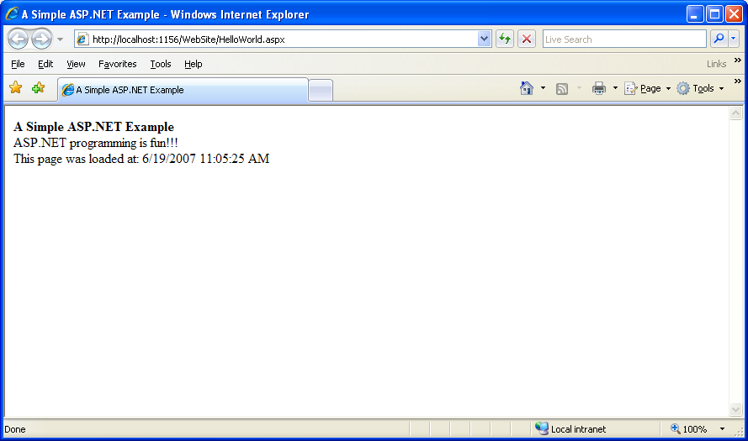
A Simple ASP.NET Example

Slide 25
A Simple ASP.NET Example

Slide 26
Visual Studio
One of the best features of ASP.NET is Visual Studio, the integrated development environment that combines a Web-page editor, a code editor, a debugger, and several other development tools into one easy-to-use program.
The more you work with Visual Studio, the more you come to appreciate the many ways it simplifies the job of creating ASP.NET Web applications.

Slide 27
Visual Studio

Slide 28
Web Forms
<form> tag
Designate ASP.NET Web Form
Web controls
Web server controls
Form-like controls such as drop-down lists and text boxes
Validation controls (validators)
Required field validator
Range validator

Slide 29
Web Forms
<%@ Page Language="C#" %>
<!DOCTYPE html PUBLIC "-//W3C//DTD XHTML 1.0 Transitional//EN" "http://www.w3.org/TR/xhtml1/DTD/xhtml1-transitional.dtd">
<script runat="server">
</script>
<html xmlns="http://www.w3.org/1999/xhtml" >
<head runat="server">
<title>Untitled Page</title>
</head>
<body>
<form id="form1" runat="server">
<div>
</div>
</form>
</body>
</html>

Slide 30
ASP.NET Controls
ASP.NET contains a large set of HTML controls. Almost all HTML elements on a page can be defined as ASP.NET control objects that can be controlled by scripts.
ASP.NET also contains a new set of object oriented input controls, like programmable list boxes and validation controls.
The controls use syntax such as the following:
<asp:Label ID="Label1" runat="server" Text="Label"></asp:Label>
<asp:TextBox ID="TextBox1" runat="server"></asp:TextBox>
<asp:Button ID="Button1" runat="server" Text="Button" />

Slide 31
Web Controls
Text and Graphics Control
Label, Button, TextBox, Image RadioButtonList and DropDownList

Slide 32
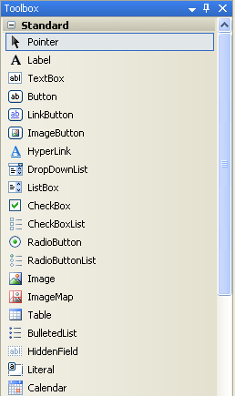
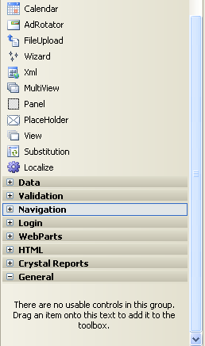
ASP.NET Controls
Web Controls

Slide 33
Validation Controls
Validation Controls
Determines whether the data in another Web control are in the proper format
Validates user input

Slide 34
Validation Controls

Slide 35
Event Aware Controls
All ASP.NET objects on a Web page can expose events that can be processed by ASP.NET code.
Load, Click and Change events handled by code makes coding much simpler and much better organized.
<asp:Button ID="Button1" runat="server" Text="Button" OnClick="Button1_Click" />
protected void Button1_Click(object sender, EventArgs e)
{
// Statement
}

Slide 36
Code-Behind Approach
Alternative method of adding scripts to make static content dynamic
Not included in the .aspx file
Must be compiled first
Two source files:
The markup file (or the .aspx file) defines the appearance of the Web page.
The code-behind file (or the .aspx.cs or .aspx.vb file)

Slide 37
A Simple Web Application
To help you understand how a typical ASP.NET application works, the next slide presents a simple calculator application: It lets the user enter two numbers, and when the user then clicks the [Add] button, the application adds up the two numbers and displays the result.

Slide 38
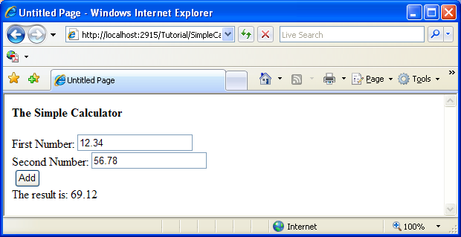
A Simple Web Application

Slide 39
A Simple Web Application
The Simple Calculator page includes four controls:
A text box that lets the user enter the first number to be added.
Another text box that lets the user enter the second number to be added.
A button the user can click to submit the page and calculate the sum of the two numbers.
A label that displays the result of the addition.

Slide 40
A Simple Web Application
To develop a single-page ASP.NET application such as the Simple Calculator application, you create two source files:
The markup file (or the .aspx file) defines the appearance of the Web page.
The code-behind file (or the .aspx.cs or .aspx.vb file)

Slide 41
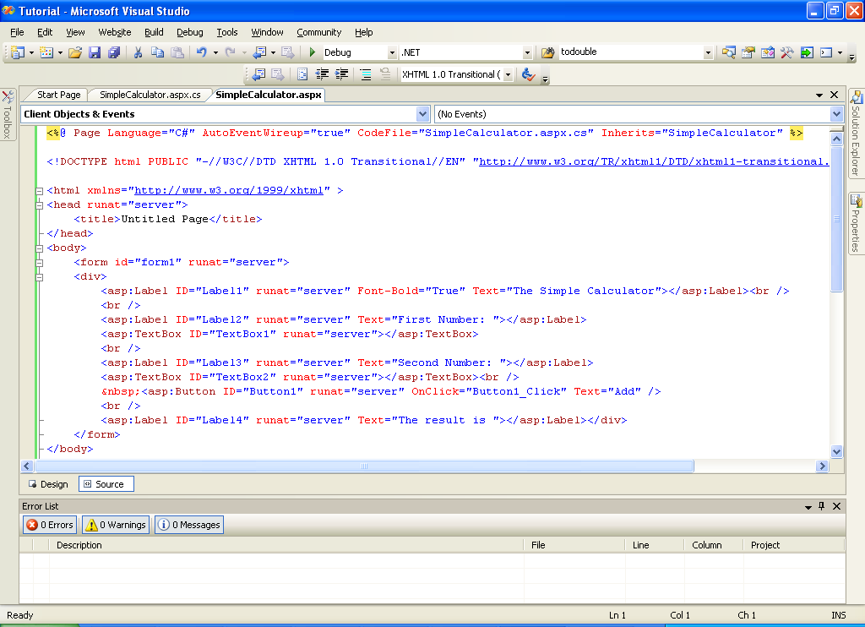
The appearance of the Simple Calculator (C#)

Slide 42
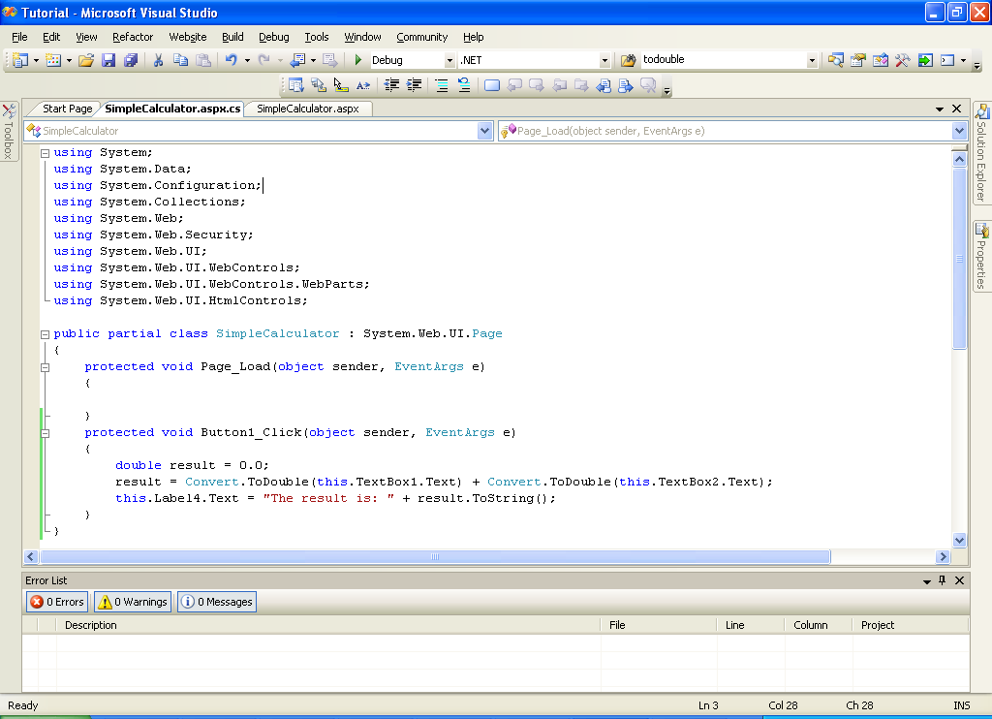
The Code-Behind File of the Simple Calculator Application

Slide 43
Creating Your First ASP.NET Application
Visual Studio organizes the files of an ASP.NET application by using logical containers called projects and solutions.
A project is a container that holds all files related to a single ASP.NET application — including the .aspx files that define the application’s Web pages, the code-behind files that provide the code executed when the application runs, and other files used by the application.
A solution is a container that can hold one or more projects. Solutions let you group related applications.
Most solutions contain just a single project. In fact, when you create a new Web application, Visual Studio creates two containers: a project to hold the application’s files and a solution to hold the project.

Slide 44
Creating a New Web Site
To create a new Web site in Visual Studio, follow these steps:
Choose the File➪New➪Web Site command.
Choose ASP.NET Web Site from the list of available templates.
Enter the location for the Web site.
Click OK.

Slide 45
Adding Pages
Right Click Website➪Add New Item.
Make sure Web Form is selected in the Templates box.
Enter a name for the page in the Name text box.
Click Add.

Slide 46
Adding Web Controls
Drag and drop 4 labels, 2 textboxes and 1 button from the toolbox panel to the web form.
Change the text for the controls in the properties panel accordingly to produce a page that is same to the figure in next slide.

Slide 47
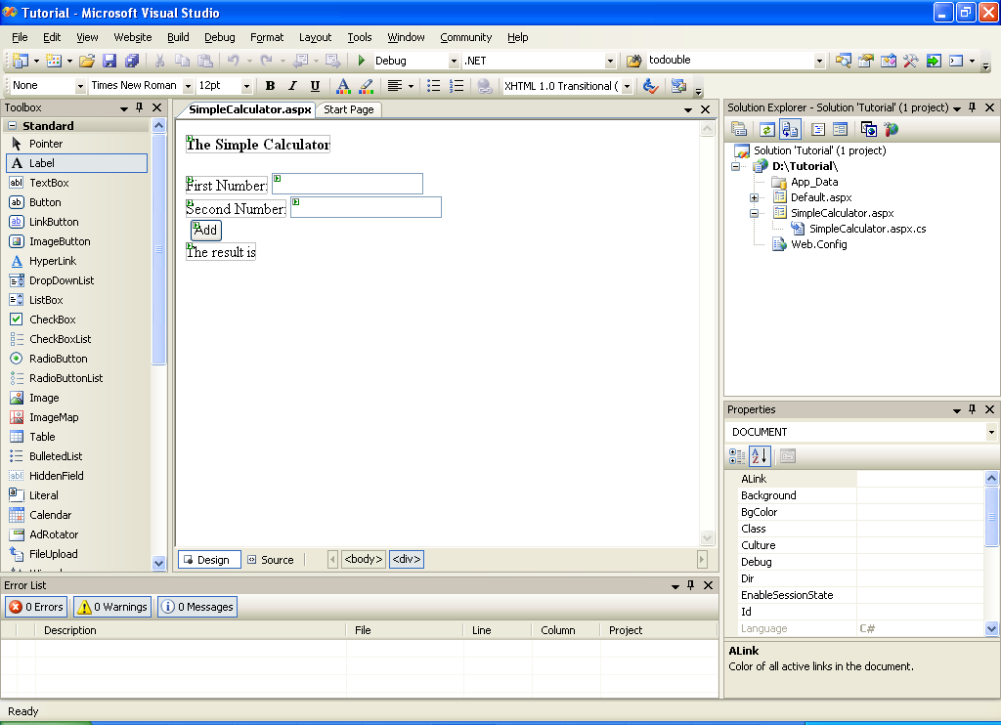
Adding Web Controls

Slide 48
Adding Action for Button
Double click the Add button on the web form
Type the following codes.
protected void Button1_Click(object sender, EventArgs e)
{
double result = 0.0;
result = Convert.ToDouble(this.TextBox1.Text)
+ Convert.ToDouble(this.TextBox2.Text);
this.Label4.Text = "The result is: " + result.ToString();
}

Slide 49
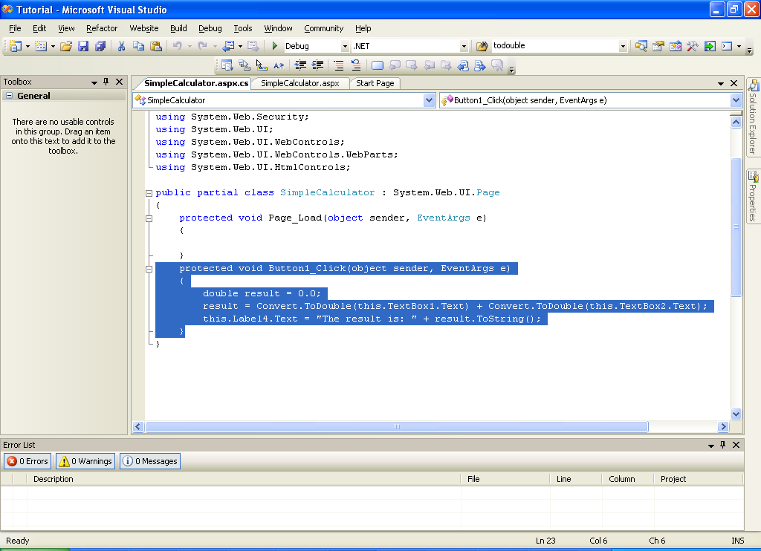
Adding Action for Button

Slide 50
Debugging and Preview in Bowser
Click the Start Debugging icon or press F5 to debug the codes and preview the web form in browser.

Slide 51
Quick Review Question
Differentiate between static and dynamic web pages.
Identify form controls in ASP.NET.
Discuss the validators in ASP.NET.

Slide 52
Summary of Main Teaching Points
ASP.Net
Form Controls
Validators
Visual Studio

Slide 53
Question and Answer Session
Q & A

Slide 54
What we will cover next
ADO.NET

